Slide 1


SOILARI TEAM 24
Hack the Globe 2023
Data-driven optimization of small-scale farms

Slide 2

Problem Statement
Smallholder farmers can lack the technical background needed to analyze existing soil and climate data, and apply those insights to optimize their farming techniques.
Large datasets are collected globally for soil composition and rainfall
This data is analyzed widely in academia, but insights aren’t widely available, in a digestible format, to those who can benefit most from it
Without optimization, there are significant losses from excess watering and fertilization
Over-irrigation causes wasted water and energy, topsoil erosion, and contamination risk of areas downstream
PROBLEM -> SOLUTION -> TECHNICAL DEMO -> BUSINESS MODEL -> IMPACT

Slide 3
THE SCOPE
RAPIDLY CHANGING CLIMATE
INCREASING COST OF FERTILIZER
GROWING FOOD INSECURITY
In Kenya, vulnerable populations are being hit hard with growing barriers to farming:
PROBLEM -> SOLUTION -> TECHNICAL DEMO -> BUSINESS MODEL -> IMPACT

Slide 4
THE SCOPE
600 M
SMALLHOLDER FARMERS WORLDWIDE
220,000
384 M
PREDICTED END-USERS
SMALLHOLDER FARMERS IN SSA
74%
DIGITAL SIM SSA CONNECTION RATE
Assuming 4% adoption rate in pilot launch in Kenya
PROBLEM -> SOLUTION -> TECHNICAL DEMO -> BUSINESS MODEL -> IMPACT

Slide 5
Stakeholders
Rural communities that depend on locally grown crops
Small-scale farmers who rely on agriculture for income
Regions where agriculture is a significant contributor to GDP
Fertilizer and equipment suppliers
Ecosystems near farms, at risk of contamination from poor farming practices
PROBLEM -> SOLUTION -> TECHNICAL DEMO -> BUSINESS MODEL -> IMPACT

Slide 6
Solution
A web-based platform that presents simplified insights from aggregated, location-specific soil and climate data
Digestible soil and climate data insights
Calculated maximum irrigation capacity of farm, based on soil type and rainfall
Optimized fertilization through quantities of primary fertilizers by crop type
Accessible SMS messages that provides simple text insights and reminders
Resources for consultation, nutrient and equipment sourcing
PROBLEM -> SOLUTION -> TECHNICAL DEMO -> BUSINESS MODEL -> IMPACT

Slide 7
Technical Implementation
User Input
Data Collection
Calculation
Insights Output
Crop type
Farm location
Farm size
Soil data
Rainfall data
Crop root depth
Nutrient needs
Max irrigation capacity
Tailored water prescription
Key soil insights
Irrigation suggestions
Total quantity of fertilizer
PROBLEM -> SOLUTION -> TECHNICAL DEMO -> BUSINESS MODEL -> IMPACT

Slide 8
Technical Implementation
With water holding capacity and maximum root depth data, Soilari computes the maximum amount of water that can be effectively utilized in an irrigation cycle. This helps minimize water waste and nutrient leaching.
For an inputted crop type, Soilari calculates the exact quantity of each primary fertilizer (Urea, Ammonium Phosphate, Potassium Chloride) needed per harvest to optimize macronutrients dosage, for better yield and less waste.
Max Water per Cycle = Root Depth x Soil WHC
Volume of Water per Cycle = Max. Water per Cycle x Farm Size
PROBLEM -> SOLUTION -> TECHNICAL DEMO -> BUSINESS MODEL -> IMPACT

Slide 9
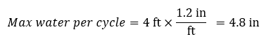
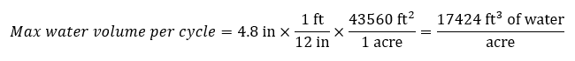
Technical Implementation
Example:
A barley farm in Kenya is found to have loamy sand-type soil with a bulk density of 1.40 Mg/m³. This soil would have an estimated WHC of 100 mm water per metre soil depth (1.2 in/ft). The maximum root depth of barley is approx. 4 ft.
Soilari will also provide tips for the rate and frequency of irrigation based on the identified soil type.
Tailored estimates for fertilizer quantities are outputted by crop.
PROBLEM -> SOLUTION -> TECHNICAL DEMO -> BUSINESS MODEL -> IMPACT

Slide 10

BUSINESS MODEL
PARTNERING
SUBSCRIPTION
CONSULTATION
COMMISSION
TARGET SALES
REDUCING COSTS
With local Sub-Saharan fertilizer producers
Retain customers through updated optimization strategies (in expansion plan)
With automated messaging bot
From each sale coming from our platform (average commission return of 5%)
Optimize production and marketing based on demand
Promote local production to reduce energy and freight costs
PROBLEM -> SOLUTION -> TECHNICAL DEMO -> BUSINESS MODEL -> IMPACT

Slide 11



IMPACT PROJECTION
~40%
INCREASED CROP YIELD
MORE EFFICIENT DISTRIBUTION CHAIN
INCREASED FOOD SECURITY
PROBLEM -> SOLUTION -> TECHNICAL DEMO -> BUSINESS MODEL -> IMPACT

Slide 12
$20,191,400
Projected profit in 5 years
PROBLEM -> SOLUTION -> TECHNICAL DEMO -> BUSINESS MODEL -> IMPACT

Slide 13
SOILARI TEAM 24
Thank you for listening!
Any questions?
Hack the Globe 2023

Slide 14
Appendix - Revenue
 | Year 1 | Year 2 | Year 3 | Year 4 | Year 5
Total Revenue (CAD)
Grants | 100,000 | 100,000 | 50,000 | 50,000 | 50,000
# of Farms | 220,000 | 226,600 | 235,664 | 235,665 | 252,162
Growth per year (%) |  | 3% | 4% | 6% | 7%
Average order total/year (CAD) | 225 | 225 | 225 | 225 | 225
Commision per order (5%) |  | 11.25 | 11.25 | 11.25 | 11.25
Average # of orders/year | 7920000 | 8157600 | 8483904 | 8483942.16 | 9077818.111
Total Revenue/year | 63,460,000 | 65,360,800 | 67,921,232 | 67,921,537 | 72,672,545
Total Cost | 68,299,327 | 63,198,107 | 53,574,374 | 53,034,843 | 52,481,078
Projected Profit (CAD) | -4,839,327 | 2,162,693 | 14,346,858 | 14,886,694 | 20,191,467

Slide 15
Appendix - Cost
 | Year 1 | Year 2 | Year 3 | Year 4 | Year 5
Stage 1: Development
Software Developer | 60,000 | 67,000 | 194,000 | 194,000 | 200,000
Database Architect | 30,000 | 30,000 | 40,000 | 40,000 | 40,000
UI Developer | 15,000 | 15,000 | 30,000 | 30,000 | 30,000
Project Manager | 80,000 | 87,000 | 167,000 | 174,000 | 180,000
Quality Assurance | 20,000 | 20,000 | 20,000 | 20,000 | 20,000
Business Analyst | 50,000 | 50,000 | 64,000 | 71,000 | 78,000
Stage 2: Service Fees
Twillio Messaging Service Fee/ | 23100 | 23793 | 24744.72 | 24744.8313 | 24744.8313
Domain Fee | 120 | 20 | 20 | 20 | 20
Stage 3: Product Test | 5,000 | 0 | 5,000 | 0 | 3,000
Stage 4: User and Partner Acquisition
Marketing | 25,000 | 25,000 | 30,000 | 35,000 | 35,000
Stage 5: Deployment
SEO (Search Engine Optimization) | 24,000 | 24,000 | 24,000 | 24,000 | 24,000
Stage 6: Maintenance and Support
UAC (User Acquitiion Cost) | 300 | 270 | 220 | 220 | 220
Total Customers | 220,000 | 226,600 | 235,664 | 235,665 | 235,665
Total Cost (CAD) | 68,299,327 | 63,198,107 | 53,574,374 | 53,034,843 | 52,481,078

Slide 16
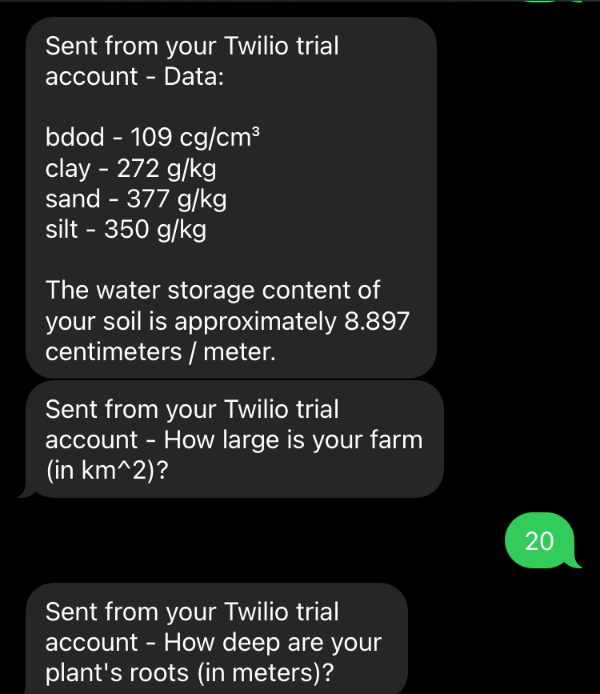
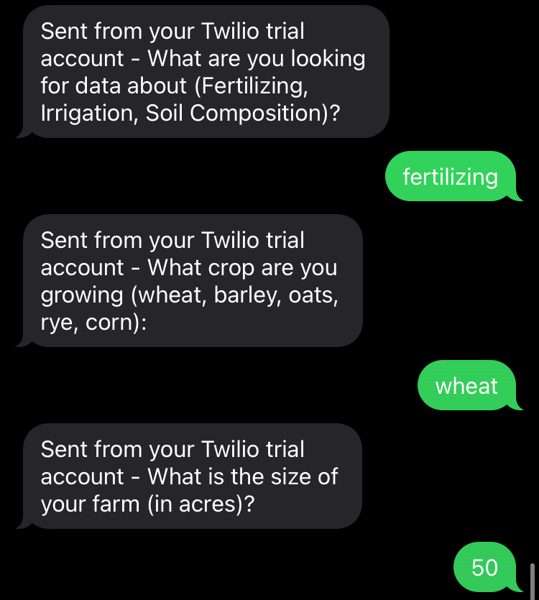
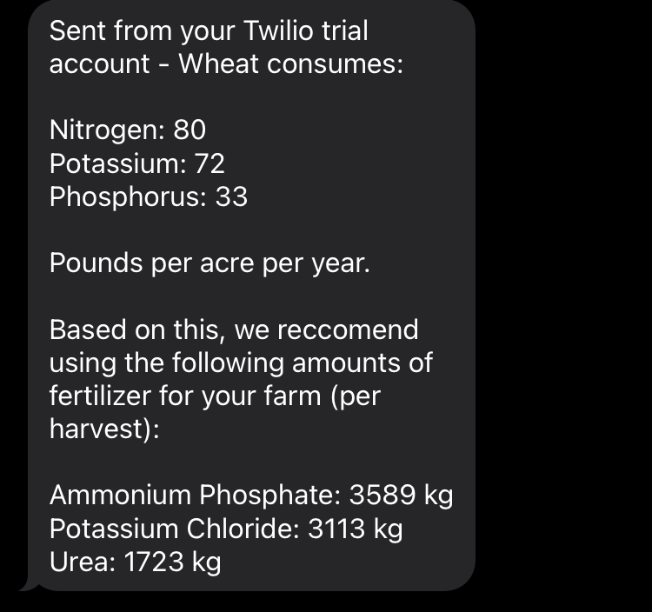
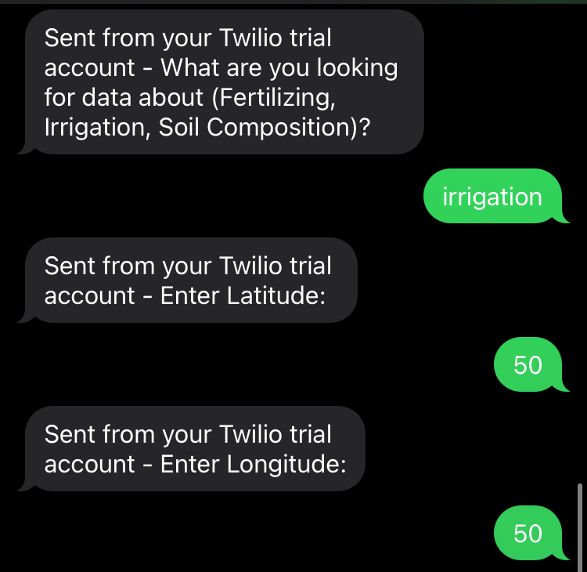
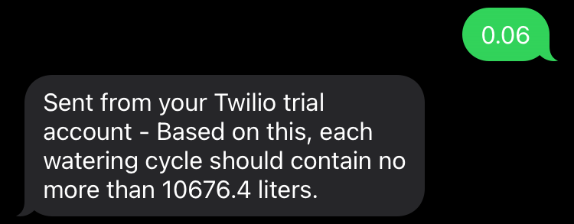
Example Messaging

Slide 17
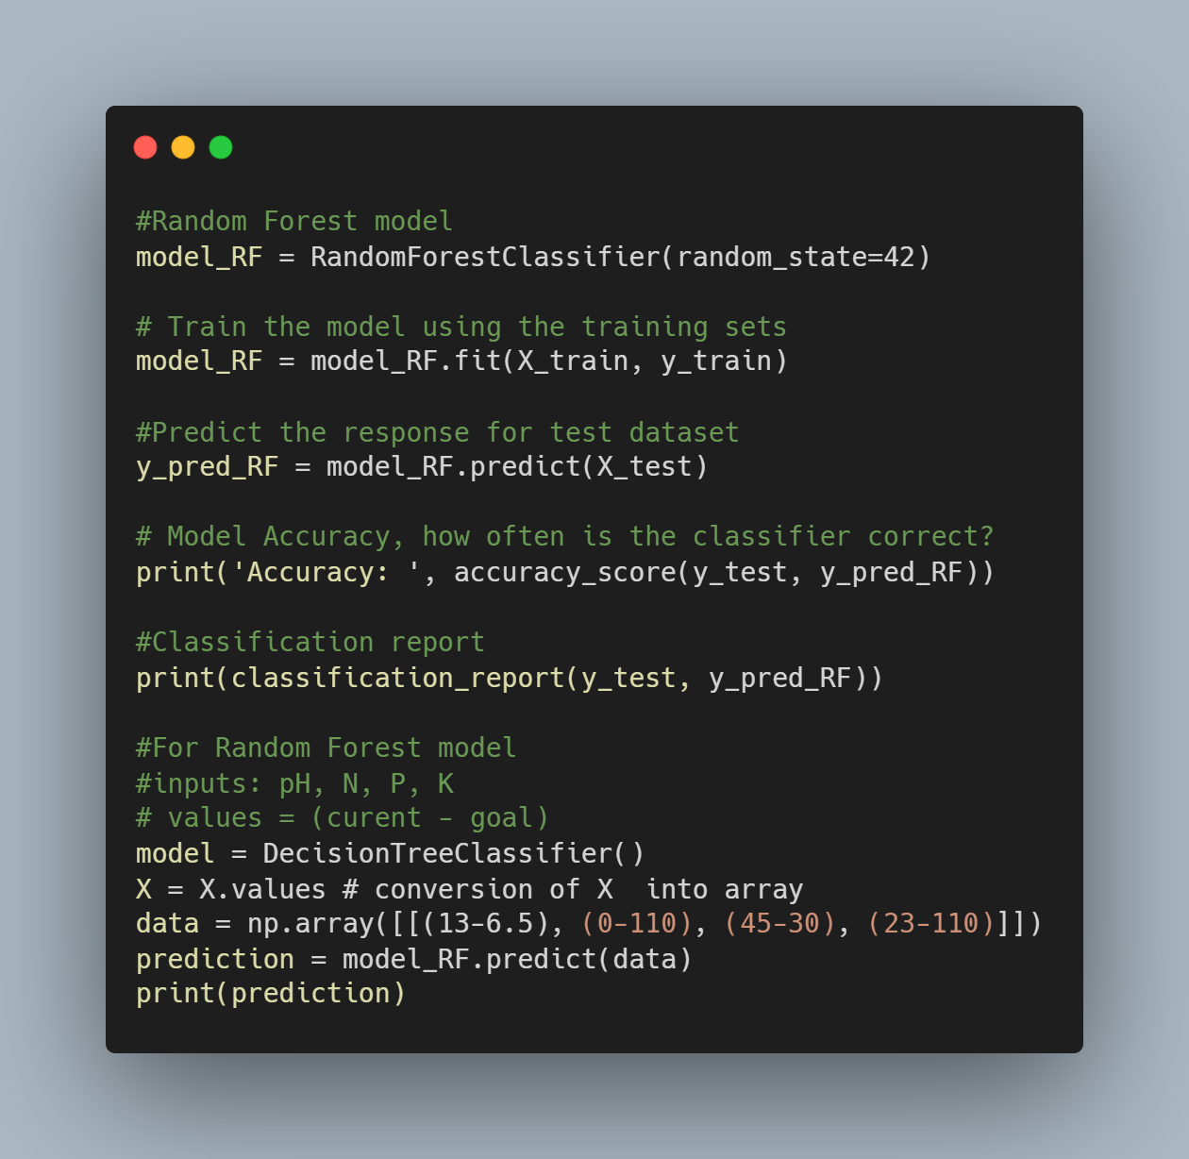
Fertilizer Recommendation (ML model)
Notes:
AINA, P. O.; PERIASWAMY, S. P.1. ESTIMATING AVAILABLE WATER-HOLDING CAPACITY OF WESTERN NIGERIAN SOILS FROM SOIL TEXTURE AND BULK DENSITY, USING CORE AND SIEVED SAMPLES. Soil Science 140(1):p 55-58, July 1985.

Slide 18
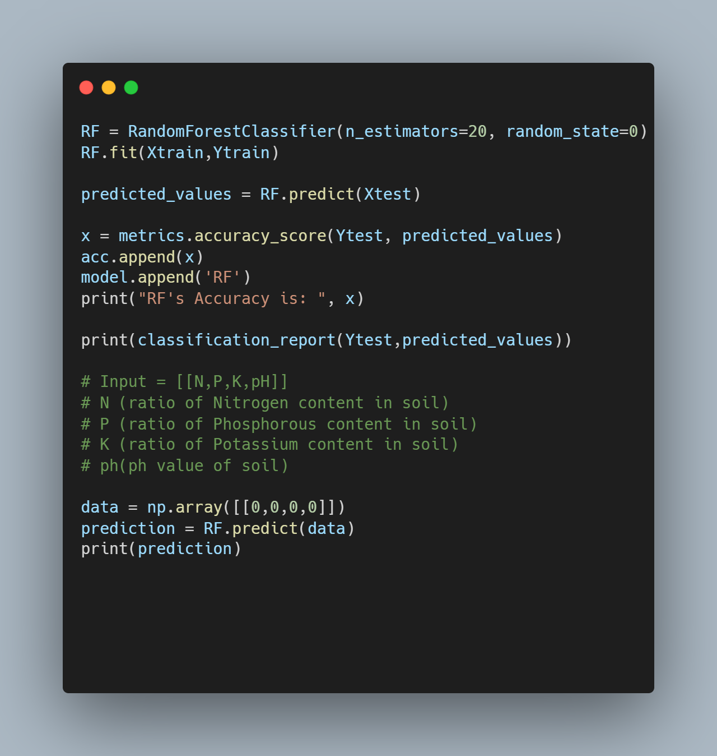
Crop Recommendation (ML model)
Notes:
AINA, P. O.; PERIASWAMY, S. P.1. ESTIMATING AVAILABLE WATER-HOLDING CAPACITY OF WESTERN NIGERIAN SOILS FROM SOIL TEXTURE AND BULK DENSITY, USING CORE AND SIEVED SAMPLES. Soil Science 140(1):p 55-58, July 1985.

Slide 19
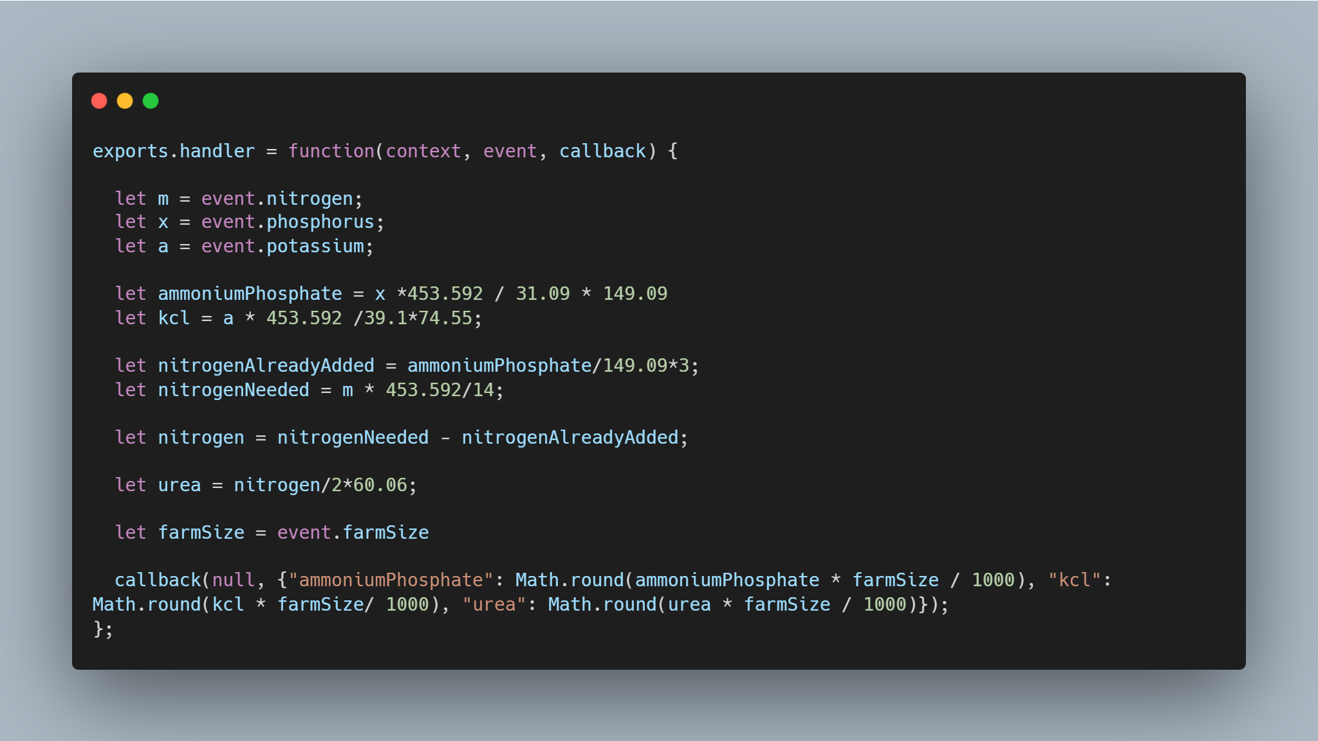
Fertilizer Recommendation (math)
Notes:
AINA, P. O.; PERIASWAMY, S. P.1. ESTIMATING AVAILABLE WATER-HOLDING CAPACITY OF WESTERN NIGERIAN SOILS FROM SOIL TEXTURE AND BULK DENSITY, USING CORE AND SIEVED SAMPLES. Soil Science 140(1):p 55-58, July 1985.

Slide 20
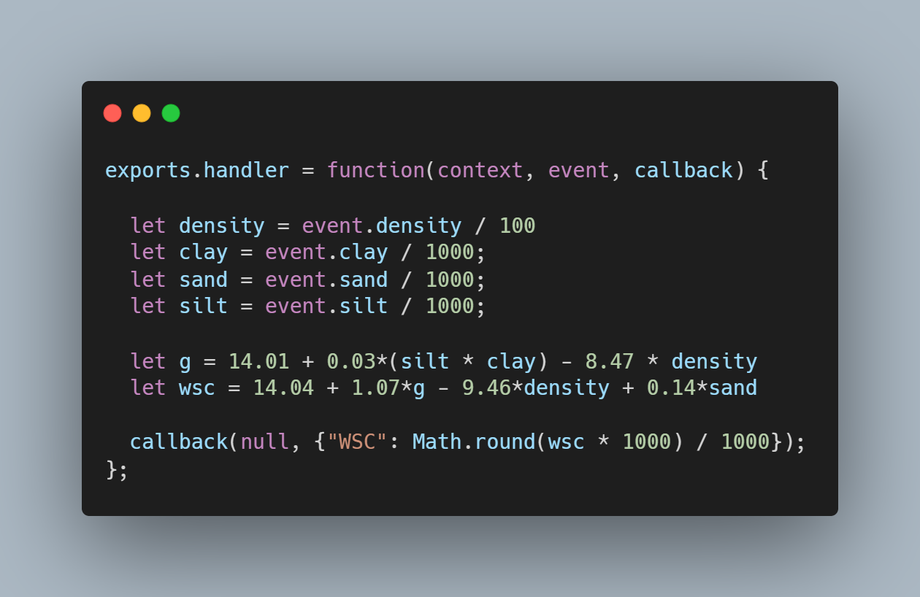
Water Storage Content (math)

Slide 21
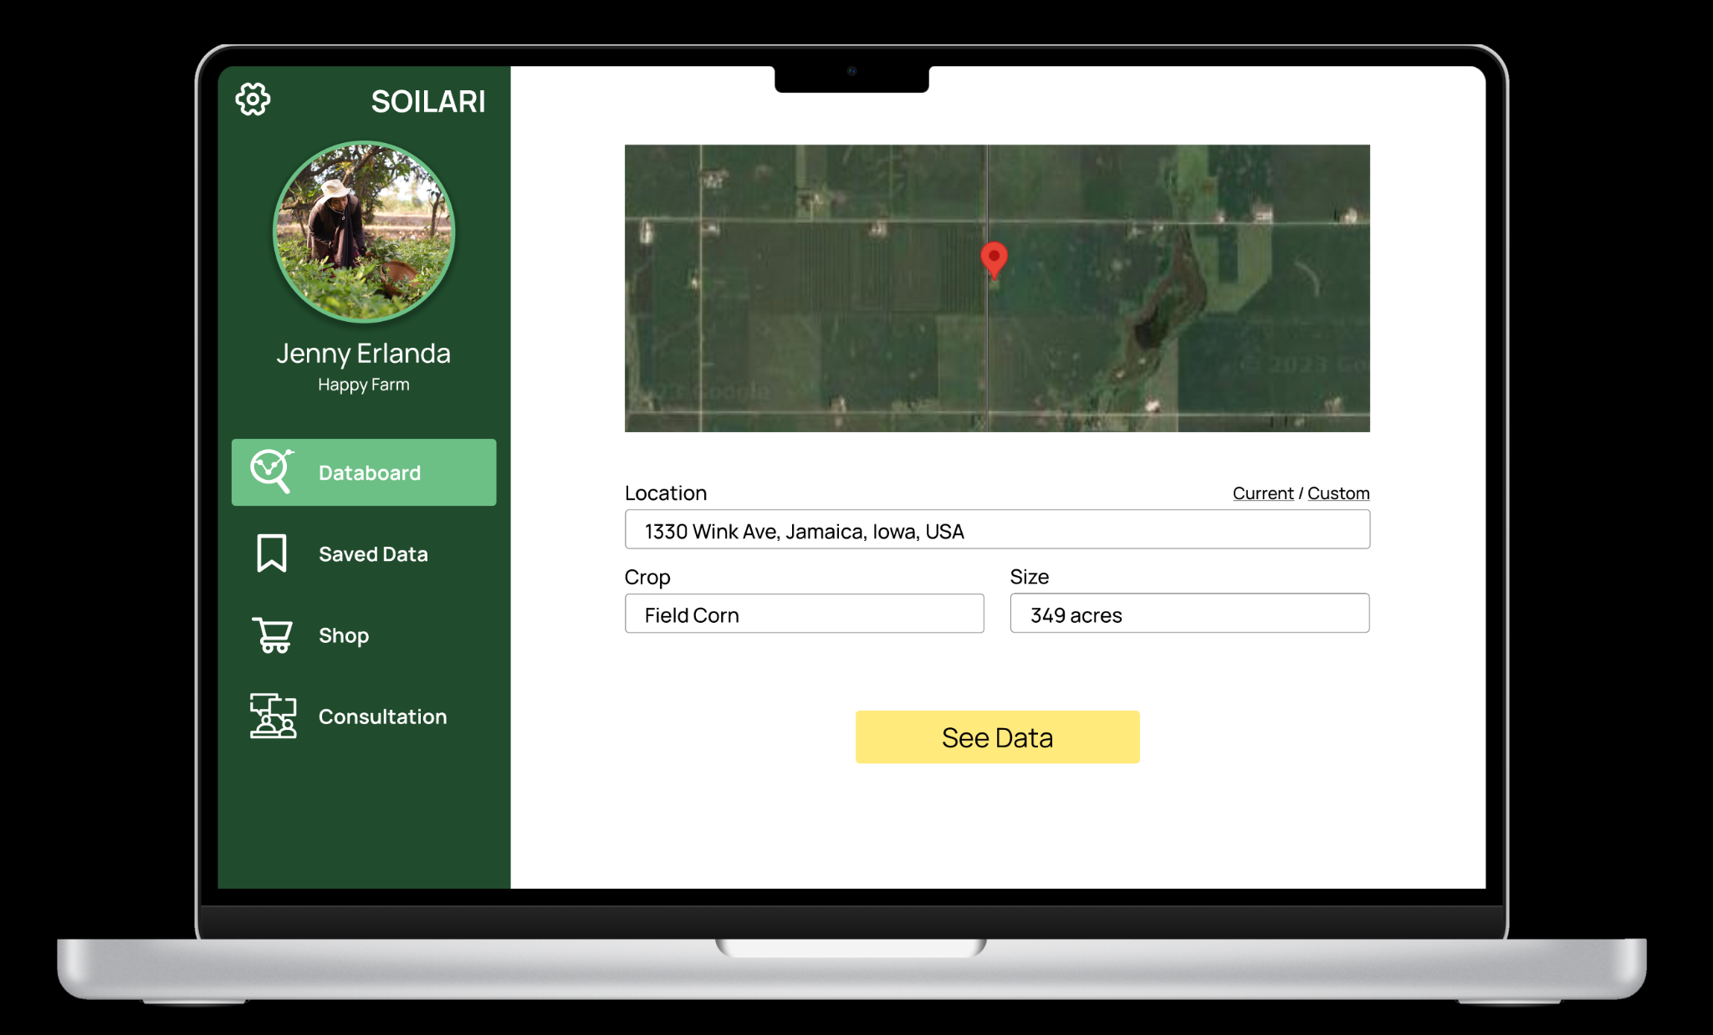
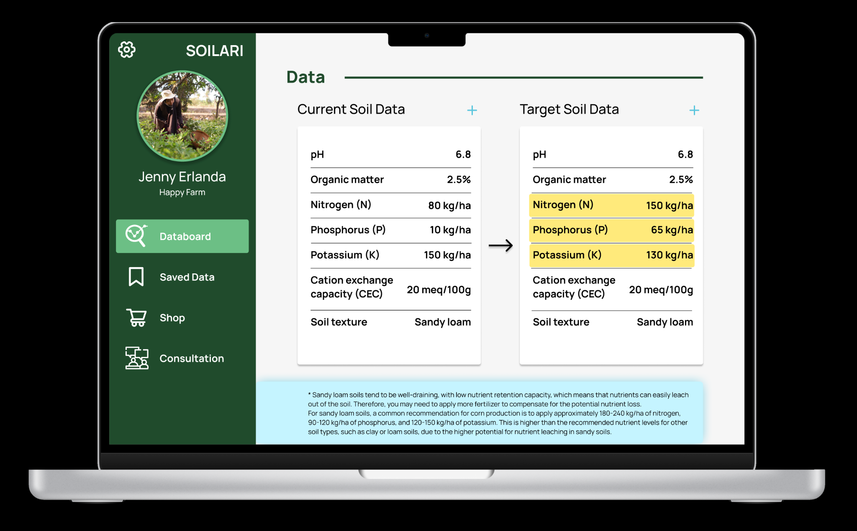
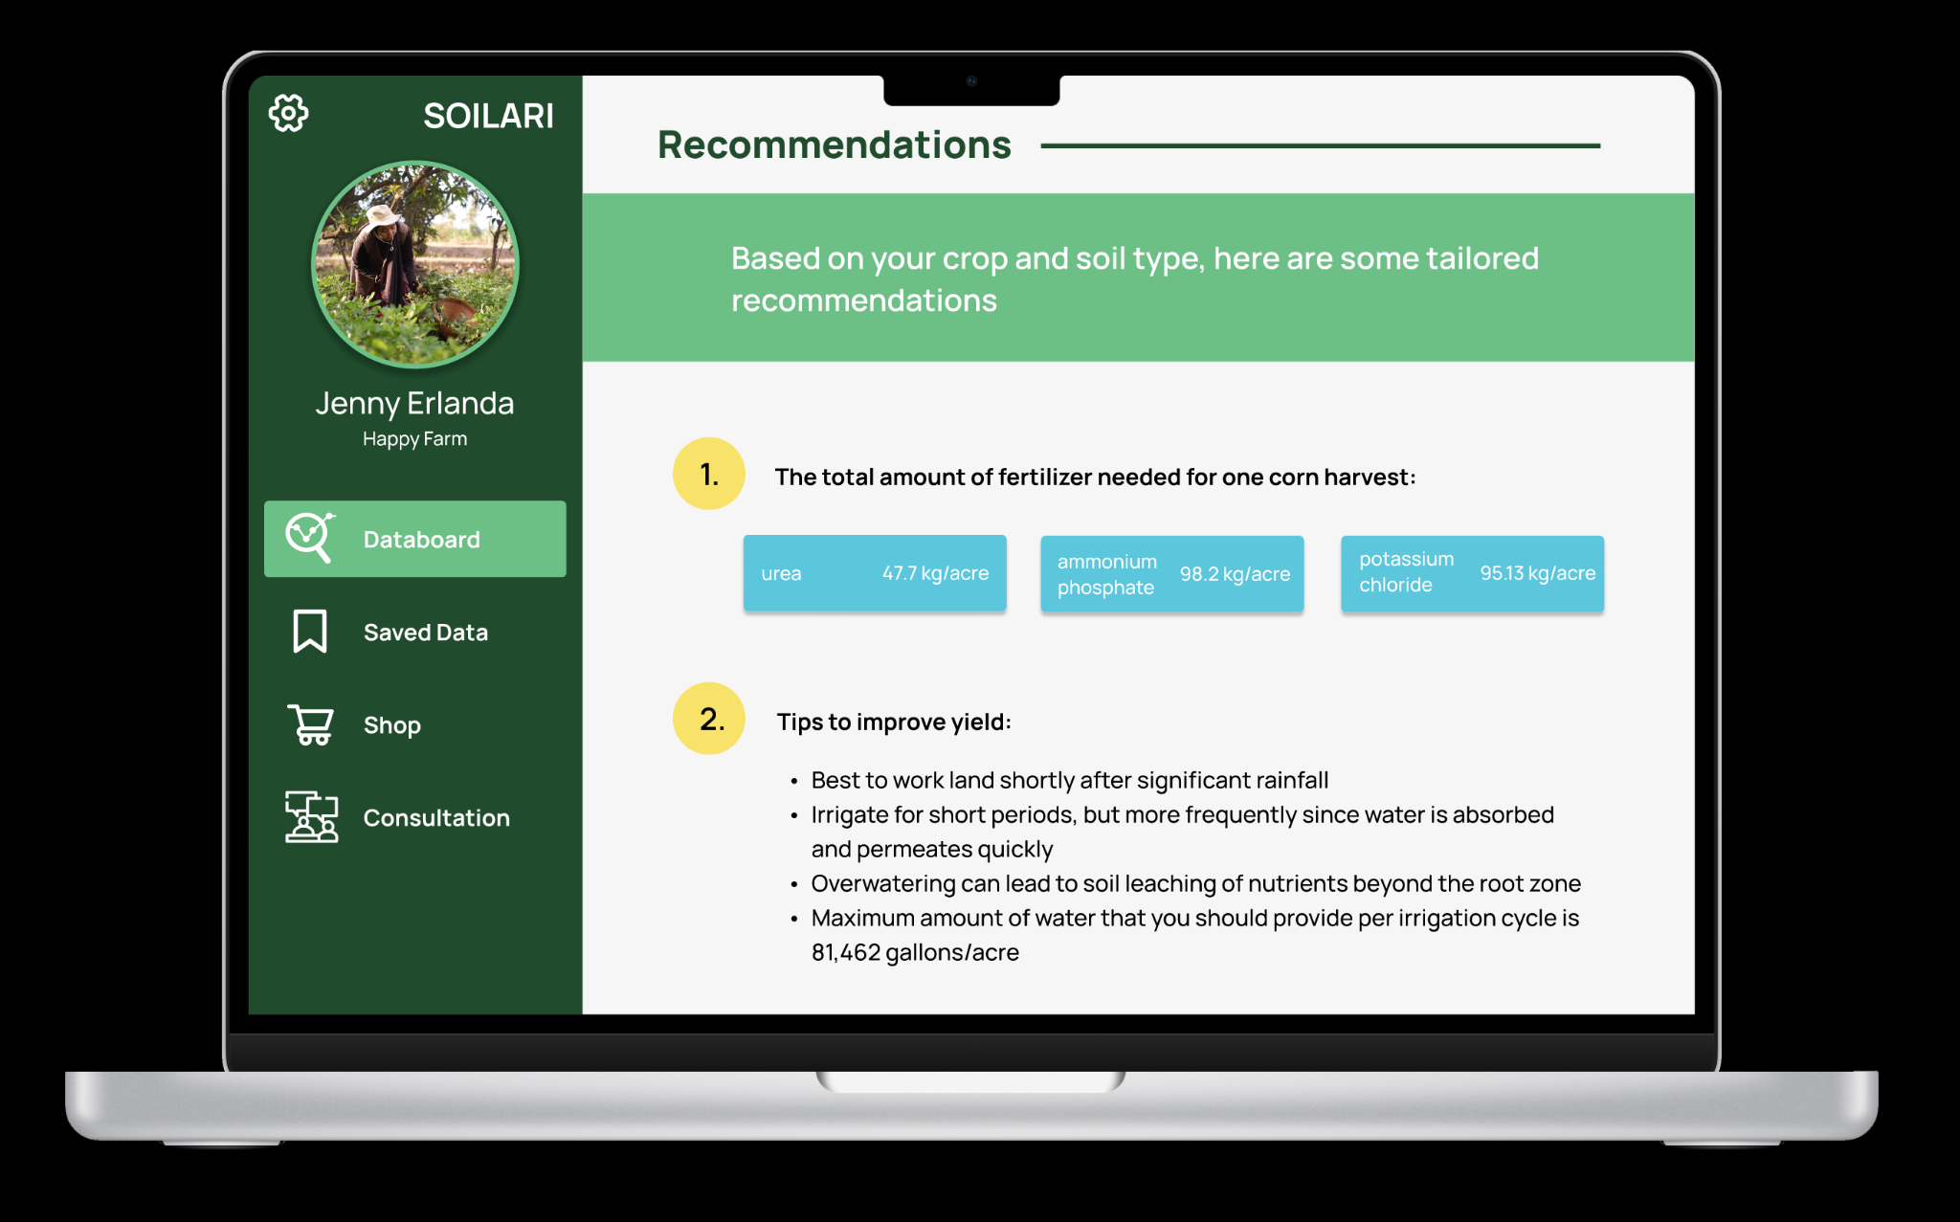
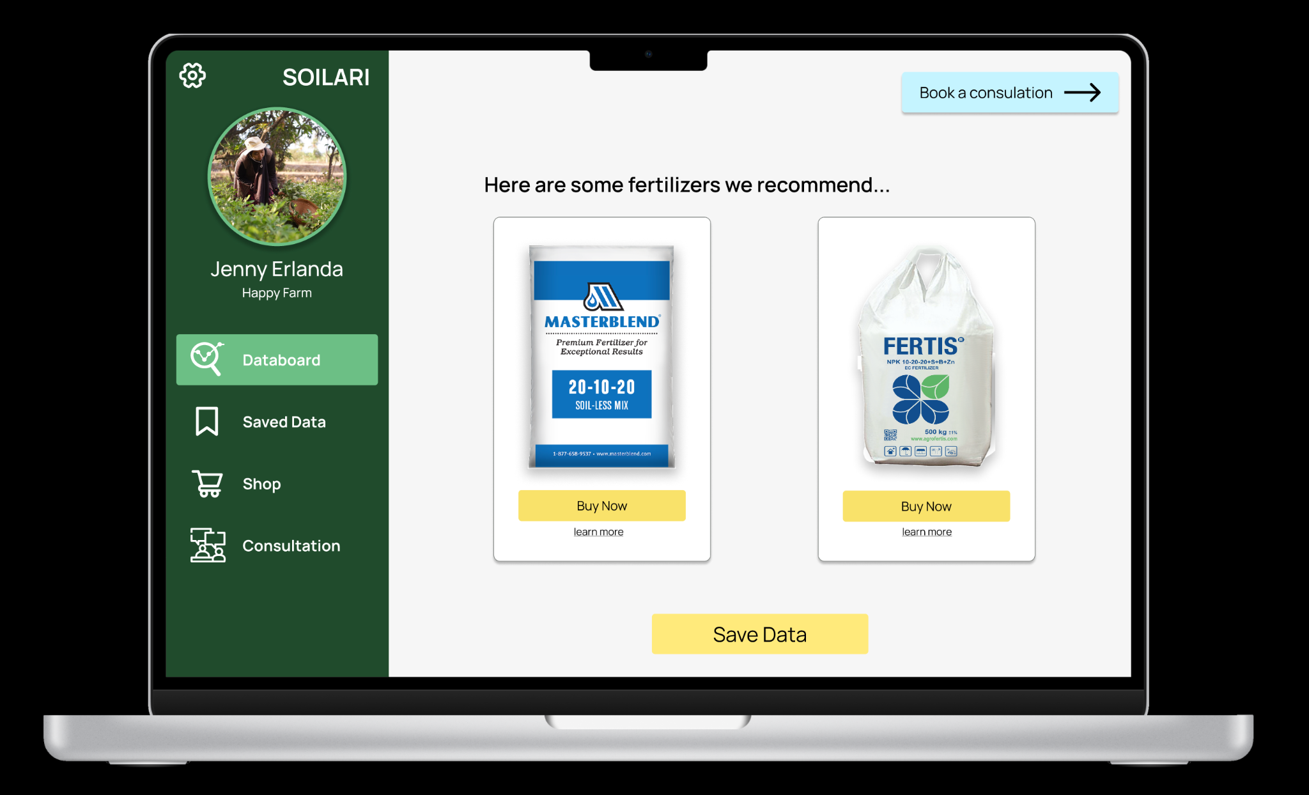
Website prototype

Slide 22
Codebase
All code and prototypes can be found https://github.com/owenmoogk/htg-2023

